Slide 1
Drawing Early-Bird Tickets: Towards More Efficient Training of Deep Networks
ICLR 2020
Citation count: 8
Haoran You, Chaojian Li, Pengfei Xu, Yonggan Fu, Yue Wang, Richard G. Baraniuk & Yingyan Lin∗
Xiaohan Chen & Zhangyang Wang∗

Slide 2
Motivation
Lottery Hypothesis claim that exist a smaller and outperform network
Iterative pruning costs time
It seems that lottery ticket fail while large learning rate
Notes:
相信大家都知道Lottery Hypothesis，給定任一神經網路θ，可以用Iterative Pruning的方式找出一個更小且Test Accuracy更高的網路，但有兩個缺點
Iterative Pruning 花時間
在訓練過程中使用大LR(0.1)，lottery ticket的test accuracy和用Random Initialize一樣(refer to Rethinking The Value of Network Pruning)

Slide 3
Background
Lottery Hypothesis
The limit of lottery hypothesis

Slide 4

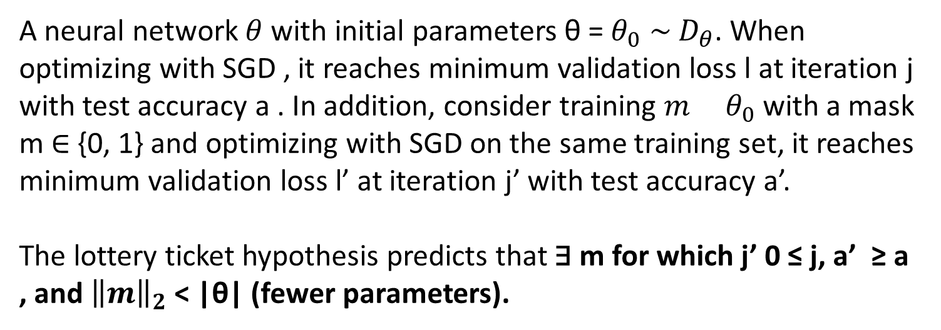
Background
Lottery Hypothesis
A neural network $θ$ with initial parameters θ = $θ_{0}$ ∼ $D_{θ}$. When optimizing with SGD , it reaches minimum validation loss l at iteration j with test accuracy a . In addition, consider training ${m θ}_{0}$ with a mask m ∈ {0, 1} and optimizing with SGD on the same training set, it reaches minimum validation loss l’ at iteration j’ with test accuracy a’.
The lottery ticket hypothesis predicts that ∃ m for which j’ 0 ≤ j, a’ ≥ a , and ${\left\|m\right\|}_{2}$ < |θ| (fewer parameters).
Notes:
給定任一神經網路θ，Exist 一個神經網路θ'，及Mask m = {0, 1}，使 = m * θ，θ >> θ'，分別訓練神經網路θ' j' iteration、θ j iteration，在同量的(commensurate)且訓練量下j' <= j，神經網路θ, θ'可以達到Test Accuracy a, a'，且a' >= a

Slide 5
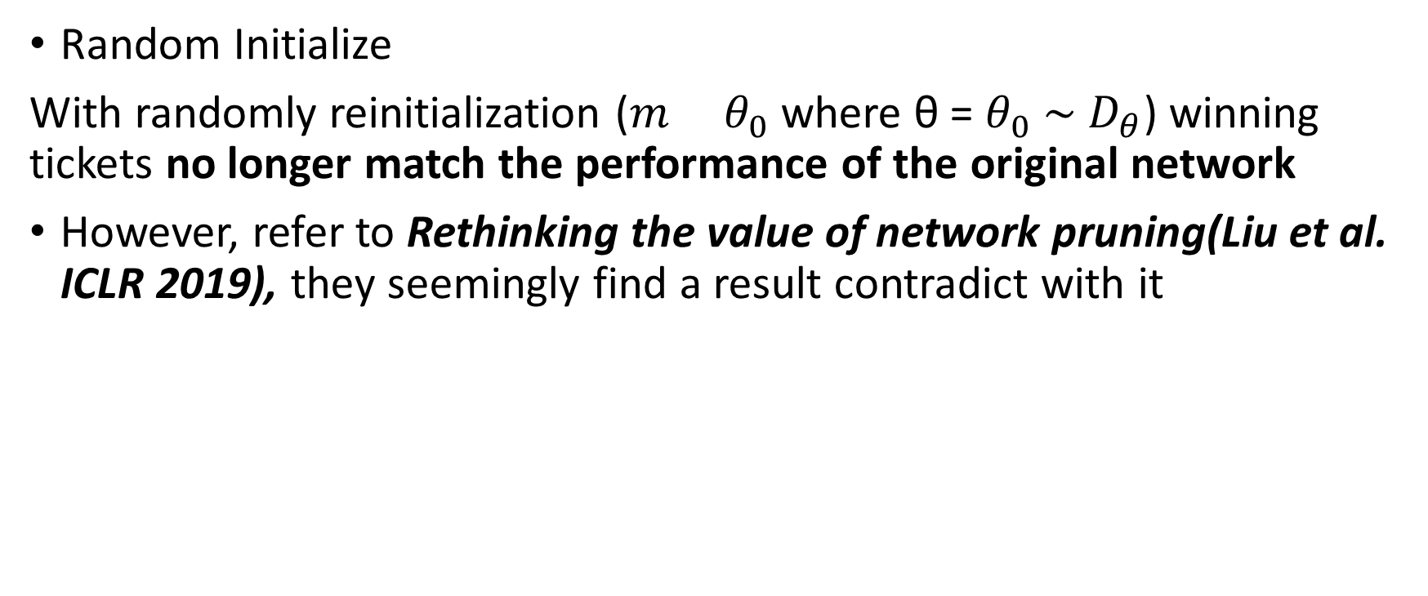
Background
Random Initialize
With randomly reinitialization (${m θ}_{0}$ where θ = $θ_{0}$ ∼ $D_{θ}$) winning tickets no longer match the performance of the original network
However, refer to Rethinking the value of network pruning(Liu et al. ICLR 2019), they seemingly find a result contradict with it

Slide 6
Background
Rethinking the value of network pruning(Liu et al. ICLR 2019).
They found the winning ticket only brings improvement in the case of unstructured pruning, with small initial learning rate, but this small learning rate yields inferior accuracy compared with the widely-used large learning rate.
Notes:
因為這個結論和EB ticket沒太大關係，所以詳細的實驗放到後面說明
但是這幾篇一起看的話會還蠻有趣的，所以放上來講

Slide 7
Problem formulation
Is there a more efficient training framework to get the lottery?

Slide 8
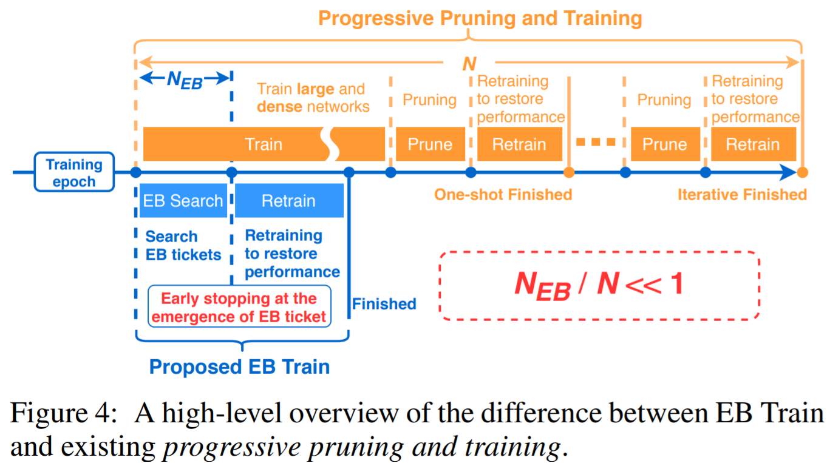
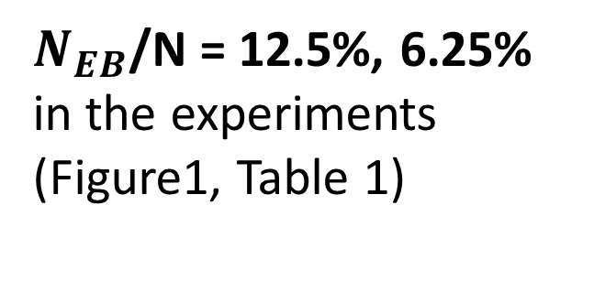
Early-Bird Ticket Algorithm
$N_{EB}$/N = 12.5%, 6.25%
in the experiments
(Figure1, Table 1)

Slide 9
Outline
Main Idea
Validation
Efficient Early-Bird Training & Experiments
Comparing with Lottery
Conclusion

Slide 10
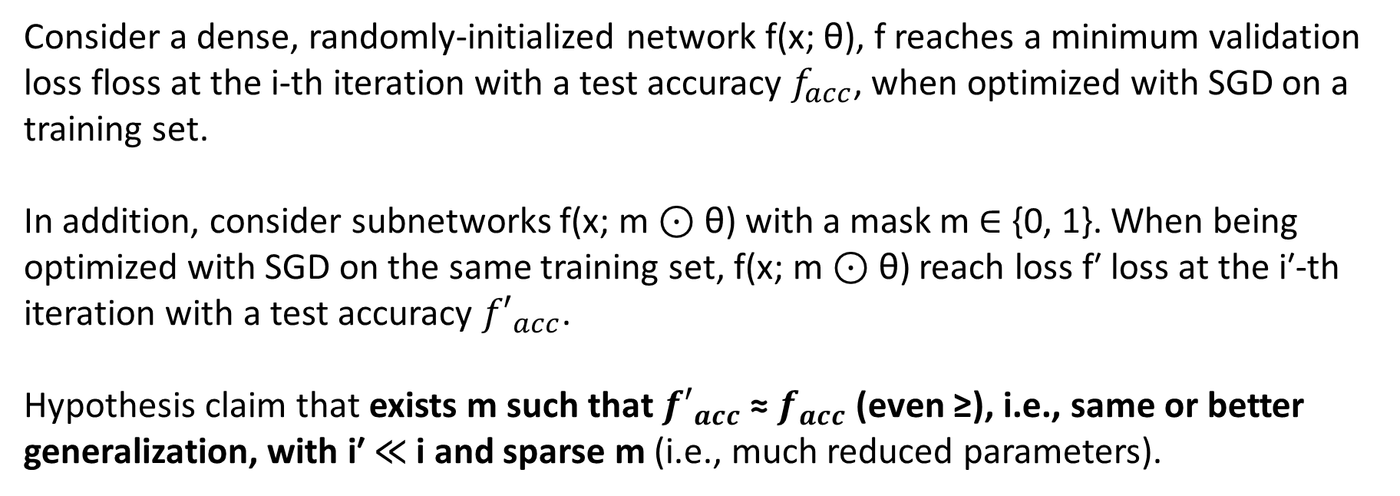
Main Idea
Early-Bird Ticket Hypothesis
Consider a dense, randomly-initialized network f(x; θ), f reaches a minimum validation loss floss at the i-th iteration with a test accuracy $f_{acc}$, when optimized with SGD on a training set.
In addition, consider subnetworks f(x; m ⊙ θ) with a mask m ∈ {0, 1}. When being optimized with SGD on the same training set, f(x; m ⊙ θ) reach loss f′ loss at the i′-th iteration with a test accuracy ${f′}_{acc}$.
Hypothesis claim that exists m such that ${f′}_{acc}$ ≈ $f_{acc}$ (even ≥), i.e., same or better generalization, with i′ ≪ i and sparse m (i.e., much reduced parameters).
Notes:
Mask: indicate pruned(0)和保留(1)

Slide 11
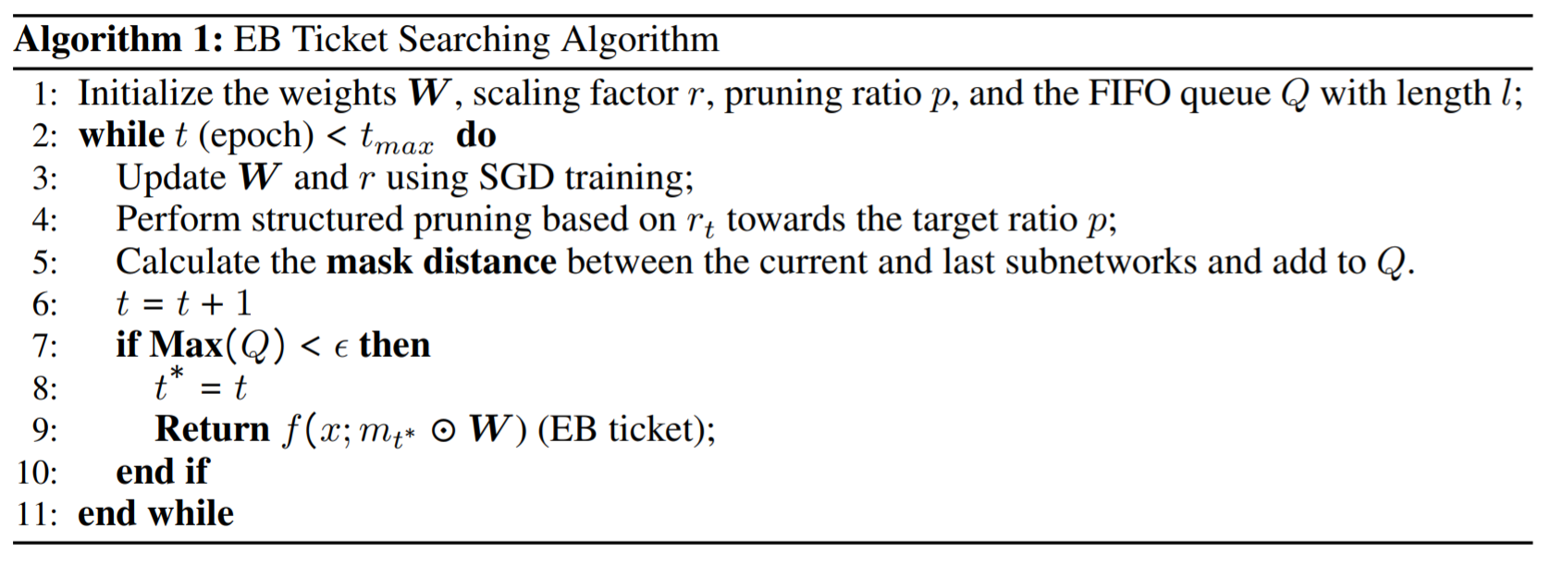
Main Idea
Implement Early-Bird Ticket
The pruning ratio p, length of queue and threshold Ɛ are hyperparameters
By default Ɛ = 0.1
Notes:
Simply to say, the algorithm will train the original network with SGD and **prune the channels in *p%* virtually** to get the mask until **the mask distance < *Ɛ* which means the mask become stable.**
set the threshold Ɛ as 0.1 and the length of queue l as 5
The scaling factor *r* in batch normalization(BN) is a coefficient that mutiply with the weights of the network and it would be trained with SGD. The scaling factor *r* can increase the magnitude of weight and make it easier to identify the neurons should be pruned. It also be uesd in the paper [*Learning Efficient Convolutional Networks through Network Slimming (Liu et al. 2017)*](https://arxiv.org/abs/1708.06519)

Slide 12
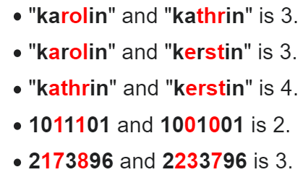
Main Idea
Measure mask distance by Hamming Distance
Which measuring the difference between 2 masks
Examples

Slide 13
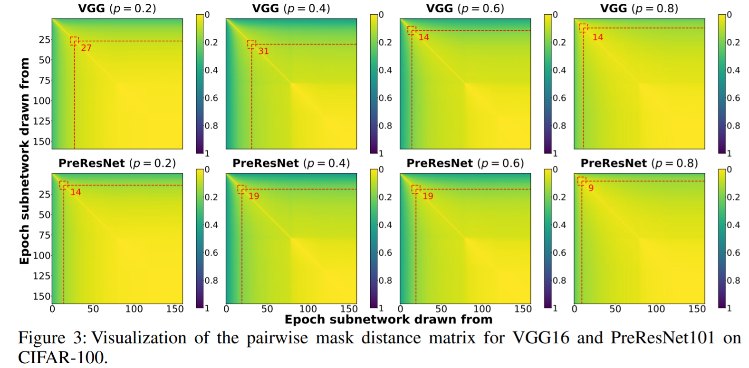
Validation
Visualize the distance of masks drawn from each epoch
X, Y axis are epochs that masks are drawn from. The red lines denote 0.1 in mask distance
Notes:
For the following figure, it shows the mask distance drawn from different epoch where **(i, j)-th element in the matrix denotes the mask distance in normalized(by the size of original network) between subnetwork drawn from i-th and j-th epochs.** The warmer, the closer. The red lines denote 0.1 in mask distance. It shows the masks of EB tickets are determined in a very early stage.
You can see

Slide 14
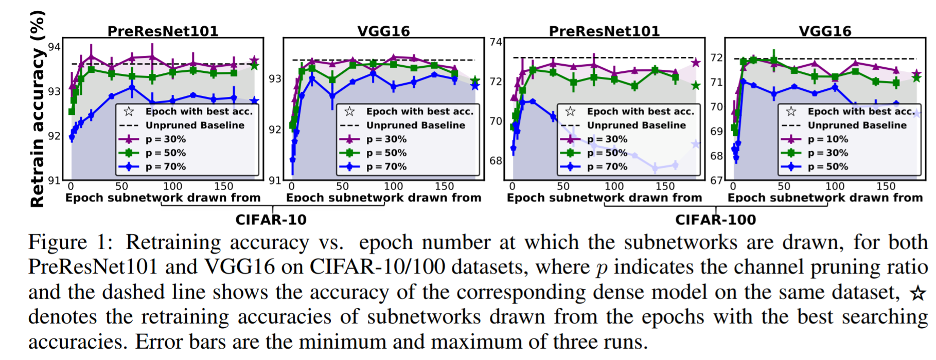
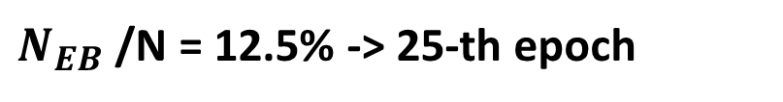
Validation
EB Tickets Emerge & Performance
$N_{EB}$/N = 12.5% -> 25-th epoch

Slide 15
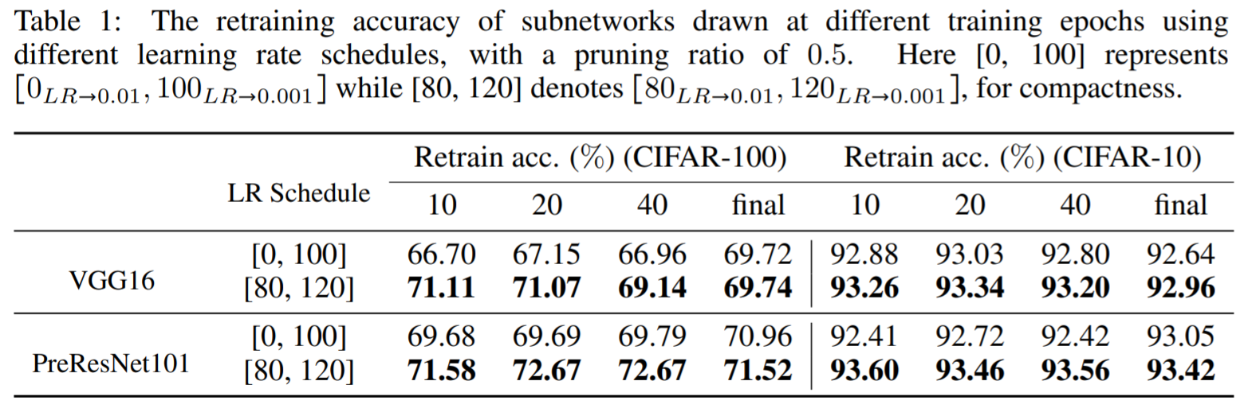
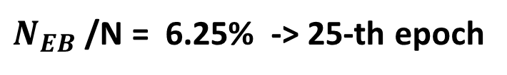
Validation
Learning Rate & Performance
Pruning Rate
$N_{EB}$/N = 6.25% -> 25-th epoch
[80, 120] means that starting from 0.1, decay to 0.01 at 80-th epoch and further decay to 0.001 at 120 epoch

Slide 16
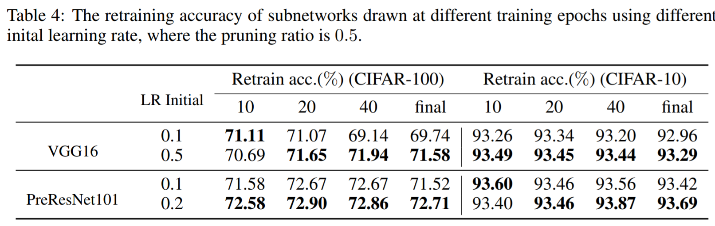
Validation
Learning Rate & Performance
Pruning Rate
0.5 means that starting from 0.5, decay to 0.01 at 80-th epoch
and further decay to 0.001 at 120 epoch

Slide 17
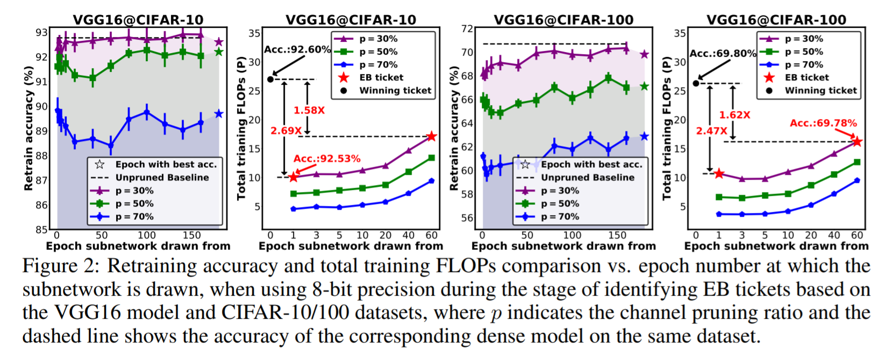
Validation
Precision & Performance & Total Training FLOPs
Ticket search in 8 bits + Retrain in 32 bits full-precision

Slide 18
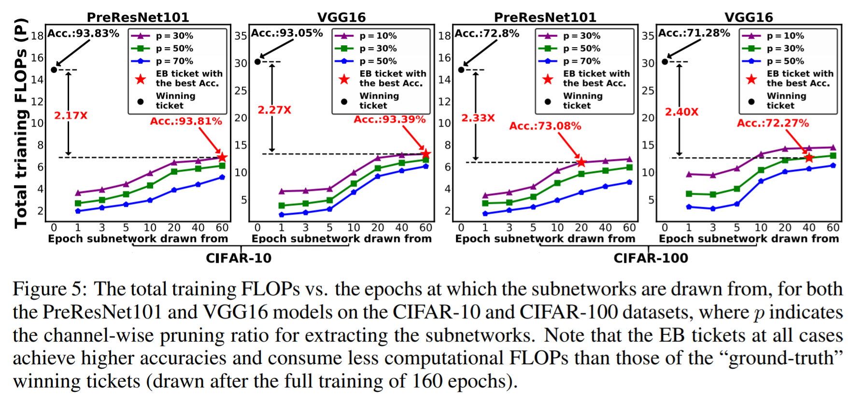
Validation
Precision & Performance & Total Training FLOPs
Ticket search in 8 bits + Retrain in 32 bits full-precision

Slide 19
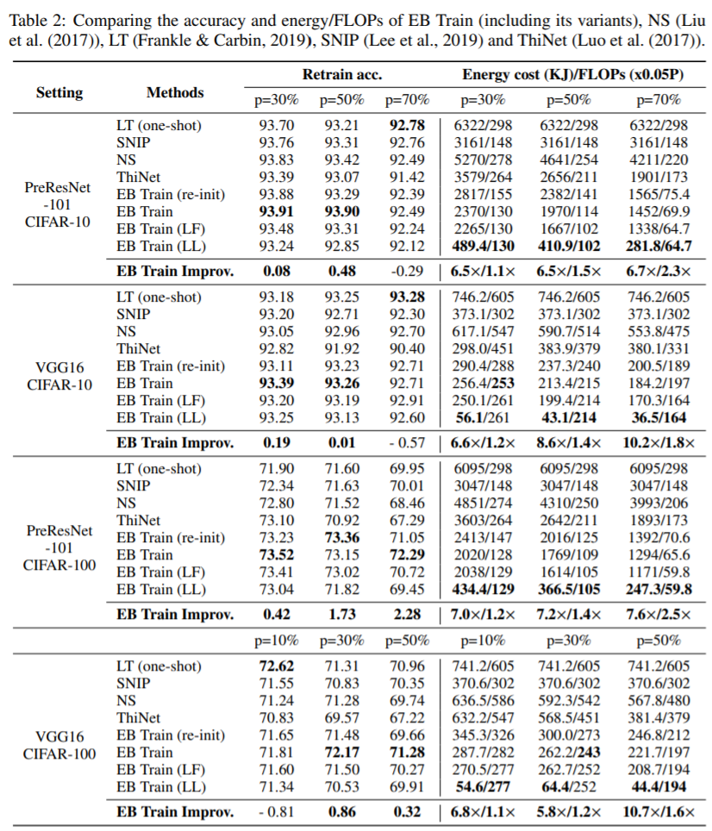
Experiments
 | Ticket Search | Retrain
LF | 32 bits | 32 bits
FF | 8 bits | 32 bits
Re-init | Retrain from a new random initialization

Slide 20
Conclusion
The pruning result has been determined in very early stage
The precision of weight doesn’t matter
It seems that retraining from random initialization doesn’t hurt the performance of EB ticket
The learning rate used here is much larger than lottery tickets

Slide 21
Learning Rate Matters

Slide 22
Rethinking the value of network pruning
ICLR 2019
Citation count: 263
Zhuang Liu, Mingjie Sun, Tinghui Zhou, Gao Huang, Trevor Darrell
Notes:
只講Lottery Ticket 有關的部分，其他實驗掠過

Slide 23
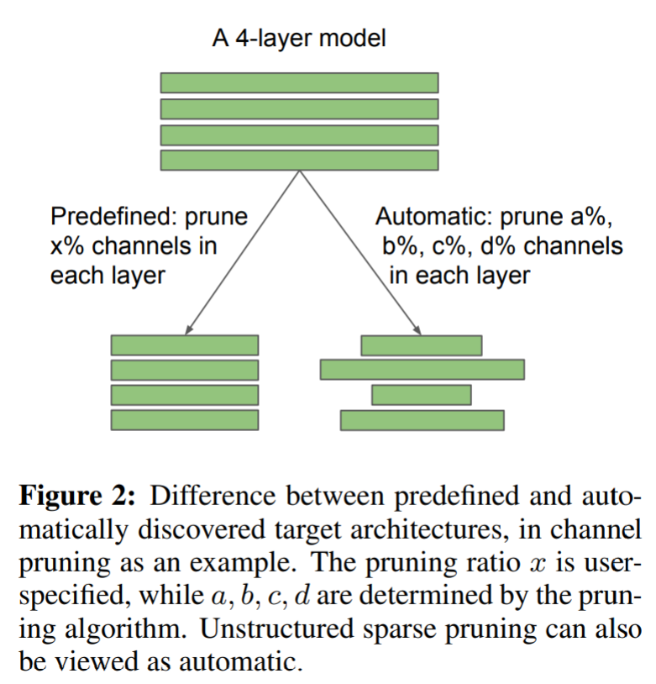
Structured Pruning & Unstructured Pruning
Structured Pruning:
Predefine p% pruning rate(pruned nodes / all nodes) for each layers
Unstructured Pruning:
Prune with different pruning rate(for each layers automatically
(Lottery Ticket)

Slide 24
Settings of Experiment on Lottery Ticket
Compare the result of structured pruning method, despite for Lottery Ticket only evaluates on unstructured pruning.
Relatively large modern models VGG16, ResNet50 used in the original pruning method than Lottery Ticket
Use momentum SGD with a large initial learning rate (0.1), while Lottery Ticket only use much smaller ones
Include the large-scale ImageNet dataset while Lottery Ticket only considers MNIST and CIFAR

Slide 25
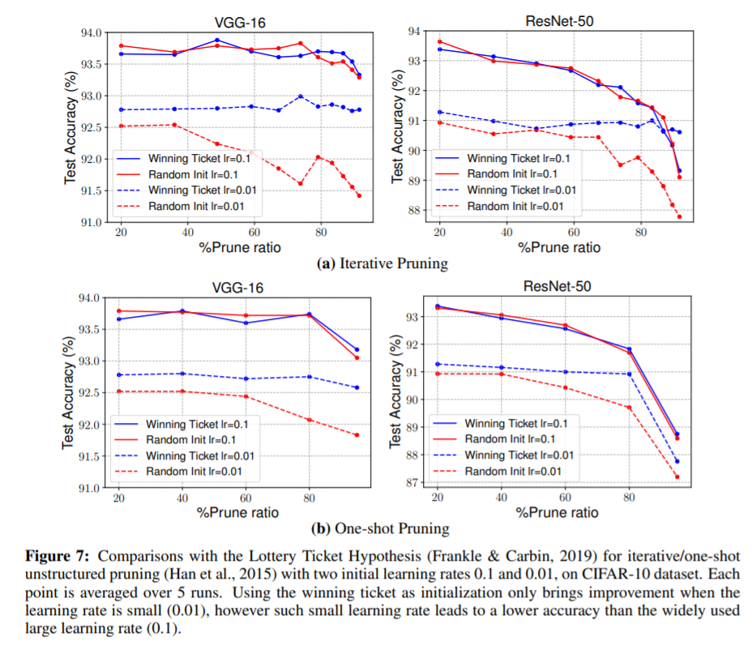
Unstructured Pruning
1. With large learning rate, performance of random initialization and lottery ticket are close
2. Using the original initialization as in Lottery Ticket only provides advantage over random initialization with small initial learning rate 0.01
Notes:
在非結構化剪枝(Unstructured Pruning)中，LR(Learning Rate)較大的時候(0.1)，Lottery Ticket相比於Random Init沒有太多優勢。如果LR(Learning Rate)較小(0.1)，結果誠如Lottery Hypothesis所言，Lottery Ticket 確實比Random Init好。但是在小LR的狀況下，無論是Lottery Ticket和Random Init結果都比大LR的結果差

Slide 26
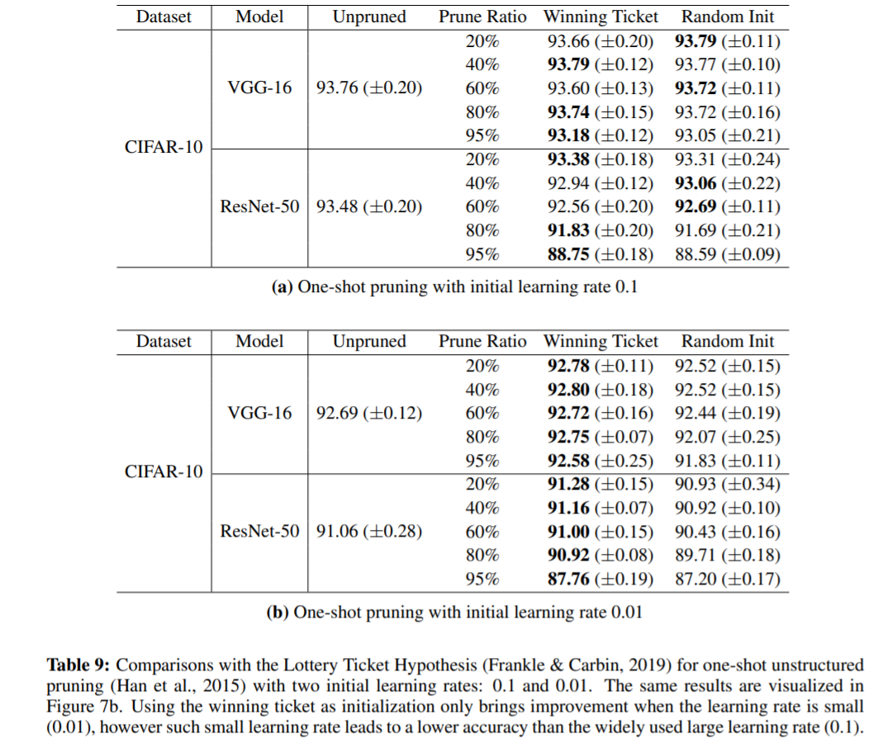
Unstructured Pruning
1. With large learning rate, performance of random initialization and lottery ticket are close
2. Using the original initialization as in Lottery Ticket only provides advantage over random initialization with small initial learning rate 0.01
Notes:
在非結構化剪枝(Unstructured Pruning)中，LR(Learning Rate)較大的時候(0.1)，Lottery Ticket相比於Random Init沒有太多優勢。如果LR(Learning Rate)較小(0.1)，結果誠如Lottery Hypothesis所言，Lottery Ticket 確實比Random Init好。但是在小LR的狀況下，無論是Lottery Ticket和Random Init結果都比大LR的結果差

Slide 27
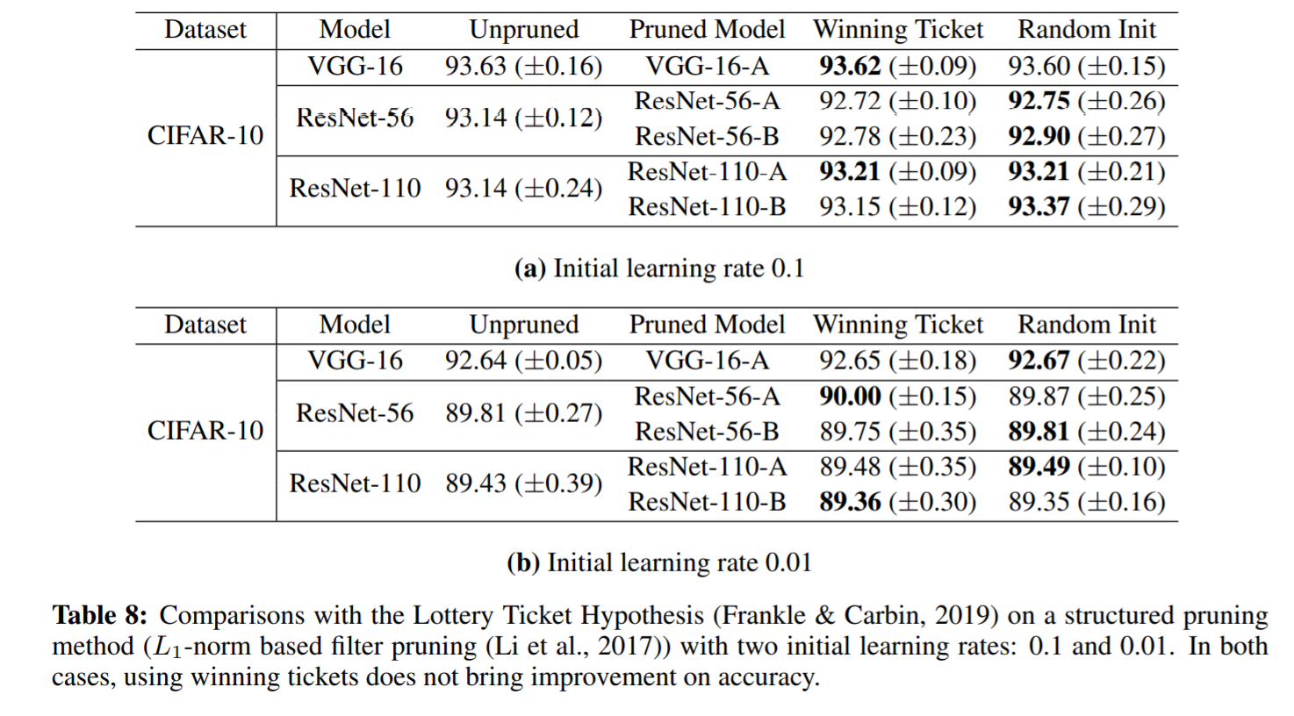
Structured Pruning
For structured pruning, Lottery Ticket doesn’t outperform random initialization
Notes:
而在結構化剪枝(Structured Pruning)中，Lottery Ticket並不會帶來比Random Init更好的Test Accuracy

Slide 28
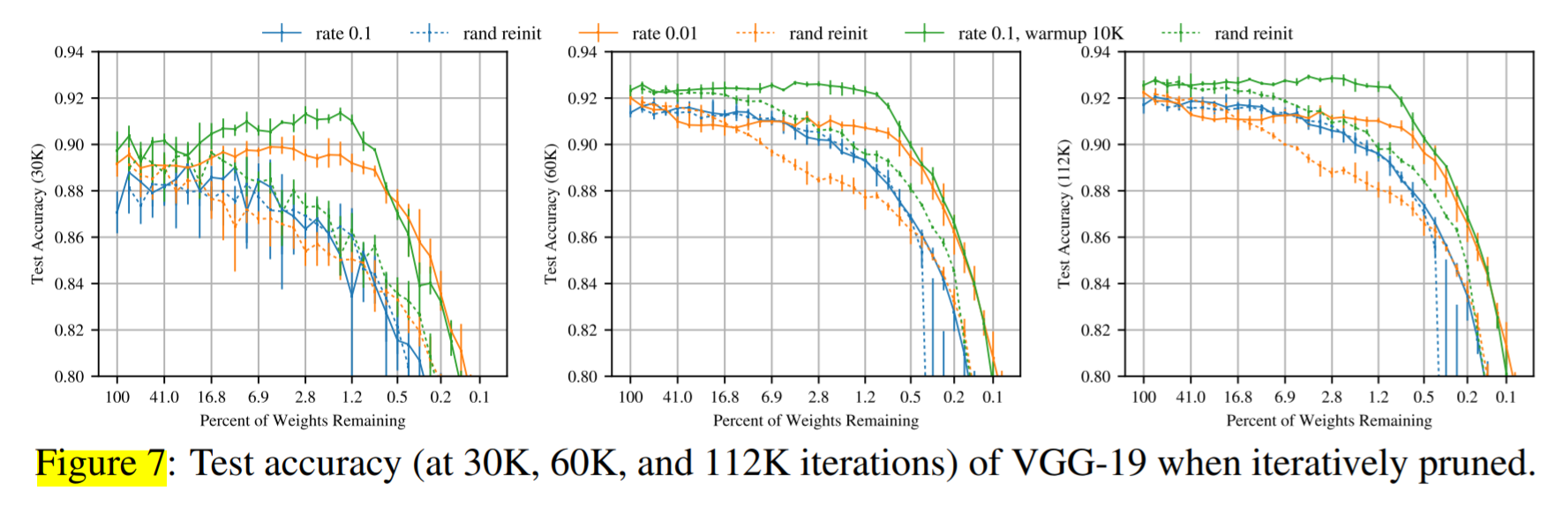
Confirm by Lottery Hypothesis
1. Doesn’t outperform but the pattern still emerge
2. Training VGG-19 with warmup (k = 10000) improves the test accuracy
Learning Rate 0.1
Notes:
在非結構化剪枝(Unstructured Pruning)中，LR(Learning Rate)較大的時候(0.1)，Lottery Ticket相比於Random Init沒有太多優勢。如果LR(Learning Rate)較小(0.1)，結果誠如Lottery Hypothesis所言，Lottery Ticket 確實比Random Init好。但是在小LR的狀況下，無論是Lottery Ticket和Random Init結果都比大LR的結果差

Slide 29
Conclusion
The lottery ticket only brings improvement in the case of unstructured pruning, with small initial learning rate, but this small learning rate yields inferior accuracy compared with the widely-used large learning rate.
For structured pruning, training the small target model from random initialization can achieve the same performance of unpruned model
Notes:
Weight不重要
Architecture重要
Initialization有爭議

